Slide 1
Project preliminary Kickoff
IBM Expert Labs
Canada life
Automated Decision Services (ADS) - POV
IBM project preliminary kickoff
date: may 5, 2026

Slide 2
Agenda
Introductions
Project description
High-level project schedule
Communication Plan
Next steps

Slide 3
Project Description
The purpose of the project is to demonstrate and validate the business and technical value of modernizing eligibility and decision-making logic for Canada Life using IBM Automation Decision Services (ADS).
Establish strong project governance and oversight to ensure controlled, on‑time delivery
Define the Proof of Value scope, success criteria, and target architecture for IBM ADS
Model and externalize eligibility decisions and rules into transparent, governed decision services
Build a working pilot decision service demonstrating real eligibility logic in ADS
Provide decision visibility through dashboards showing outcomes and business impact
Enable Canada Life teams through hands‑on training and knowledge transfer
Deliver a clear PoV readout with findings, recommendations, and a scale‑up roadmap
Note - The rules for this scope of work are deployed only in a first environment. The deployment of the rules in FIT, UAT and Prod is not included in this scope of work.

Slide 4
Introductions
Business | Name | Role
Blue Polaris | Rachel Olbur | Onshore Modeler
Blue Polaris | Aditya Sisode | Onshore Architect
Blue Polaris | James Taylor | Executive Partner
Blue Polaris | Melissa Freitas Yalta | Nearshore Modeler
Blue Polaris | Archana Patel | Onshore Engagement Manager
Blue Polaris | Arup Datta | Onshore Developer
Blue Polaris | TBD | Offshore Developer 1
Blue Polaris | TBD | Offshore Developer 2
Blue Polaris | TBD | Offshore Tester
Blue Polaris | Amit Rawool | Offshore AI/ ML Developer
Canada Life | Taylor Turner | Project Manager
Canada Life | Andy Luong | Program Manager
Canada Life | Shinina Muthiora | Tech Delivery Lead
Canada Life | George Camilieri | BSA
Canada Life | Andrew Lee | BSA
Canada Life | Kevin Mcgregor | Architect
Canada Life | Marc MacDonald | Systems Architect
Canada Life | Swapnil Parikh | BSA
Canada Life | Natalia Buneava | Sr BSS
Canada Life | Svitlana Prytuliak | Program Manager
Canada Life | Sulabh Gupta | Director, Tech Delivery Lead
Canada Life | Arzu Overington | Director, Business Delivery Lead & Product Owner
Canada Life | Petrina Bilyea | Director, GRS Initiatives
Canada Life | Natalie Staples | Director, Strategy Initiatives
Canada Life | Don McLean | PA
Canada Life | Everard Austin | Integration Tech Lead
Canada Life | Tiffany Lamirande | Manager, GRS Projects
Canada Life | Abrar Haq | AVP Enterprise Business Technology
IBM | Syed Farooq | Architect
IBM | Yan Wan | Delivery Consultant
IBM | Lelia Vazquez | Practice Manager
IBM | Barry Nesbit | TEL Seller
IBM | Brad Stern | Project Manager

Slide 5
Preliminary Project Schedule
Timeframe | SOW Activities | Key Focus & Outcomes
Week 1 (May 4–10) | 1–2 | Project governance established; formal kick‑off and stakeholder alignment.
Weeks 2–3 (May 11–24) | 3–4 | Architecture alignment, capacity planning, and PoV definition workshops complete.
Weeks 4–5 (May 25–Jun 7) | 5–6 | Eligibility decisions modeled; ADS decision and technology architecture finalized.
Weeks 6–7 (Jun 8–21) | 7–8 | Working ADS pilot built; rules implemented; decision dashboard developed.
Week 8 (Jun 22–28) | 9 | PoV results review, findings, recommendations, and artifact handover.
Weeks 9–10 (Jun 29–Jul 12) | 10 | ADS training and enablement for business and technical teams.
Weeks 11–12 (Jul 13–26) | 11–12 | Production environment support and operational knowledge transfer.

Slide 6
Project Communications
Audience | Communication Type | Purpose | Frequency | Owner
Steering Committee | Steering Committee Review | Review milestones, PoV progress, risks, and alignment to objectives | Monthly | IBM Project Manager
Project Core Team | Project Status Meeting | Coordinate delivery activities, manage issues and risks, confirm next steps | Weekly | IBM Project Manager
Project Core Team | Written Status Report | Summarize status, accomplishments, risks, and upcoming work | Weekly | IBM Project Manager

Slide 7
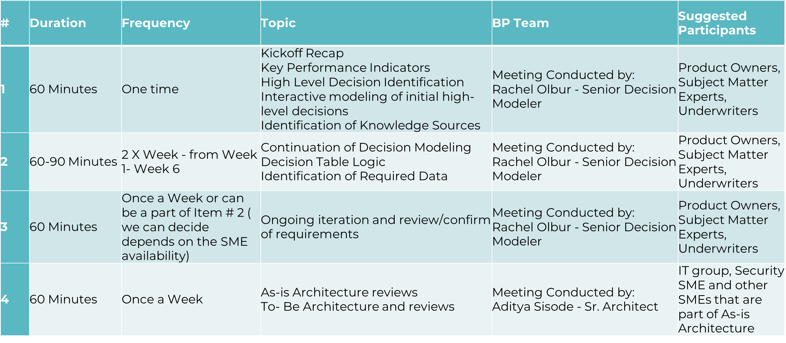
Working Meetings

Slide 8
Next Steps
Confirm, update team members as required.
Confirm Timeline and Communications.
Schedule initial workshops.
Onboard BluePolaris resources to Canada Life.
Prepare initial project plan.

